Slide 1
[ BlockFL ]
On-Device Federated Learning via Blockchain and its Latency Analysis
Kingson
kingsonwill@zju.edu.cn

Slide 2
[CATALOGUE]
目录
Part 2
BlockFL
system
Part 3
BlockFL
Algorithm
Part 4
Latency
Analysis
Part 1
Background
Knowledge
Part 6
QA
Part 5
Final
Summary

Slide 3
一
Background Knowledge
Federated Learning & Blockchain

Slide 4


Traditional Learning
Image
Centralization

Slide 5
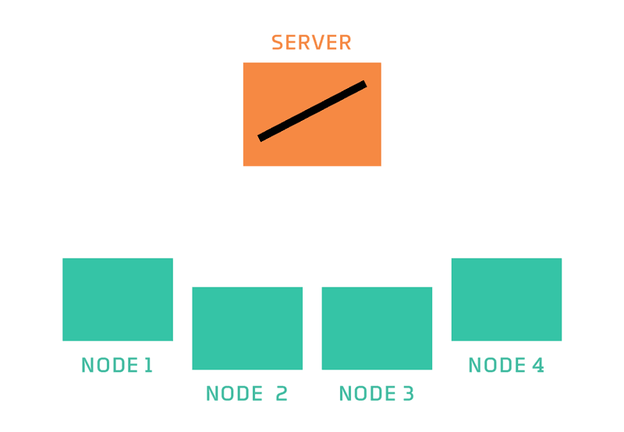
Federated Learning

Not Completely Distribution
Image
Edge Computing & Privacy Security
Application scenarios
- Driverless car
- Smart phone
- Medical data
- Wearable smart devices

Slide 6
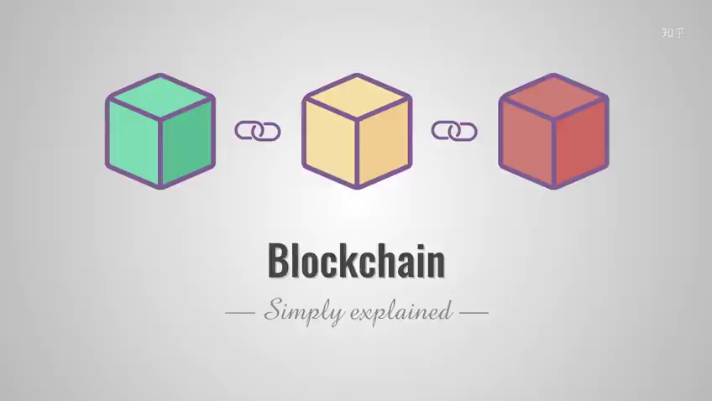
MONTE BIZ
BUSINESS REVIEW
Fast understand blockchain

Slide 7
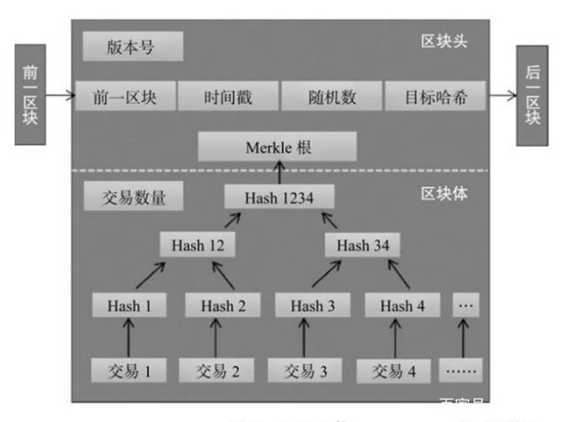

Data Structure
保证的核心：哈希运算
容易验证，但不可逆
挖矿数学：
对前块的哈希、merkle根、随机数做哈希运算，使得结果等于目标数

Slide 8
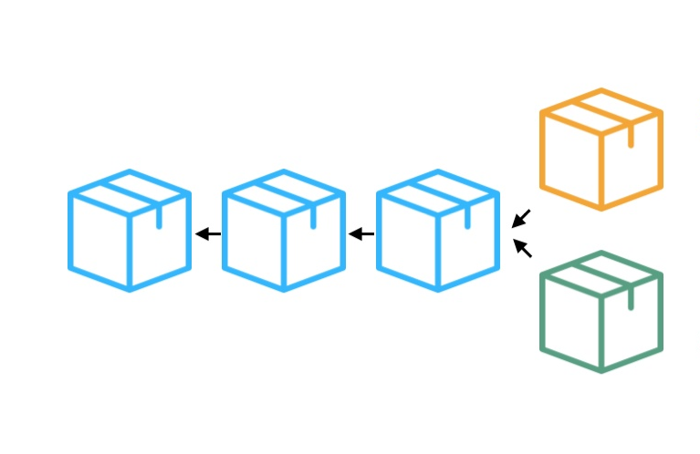
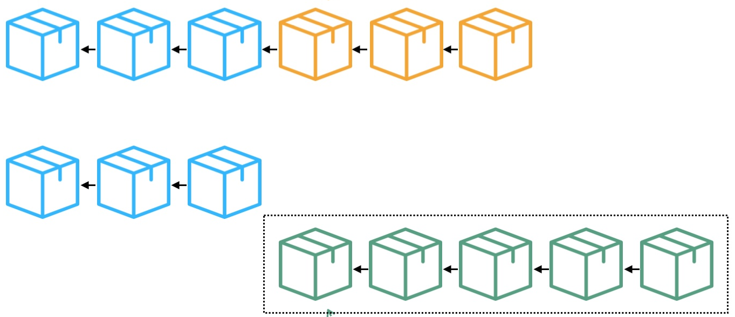
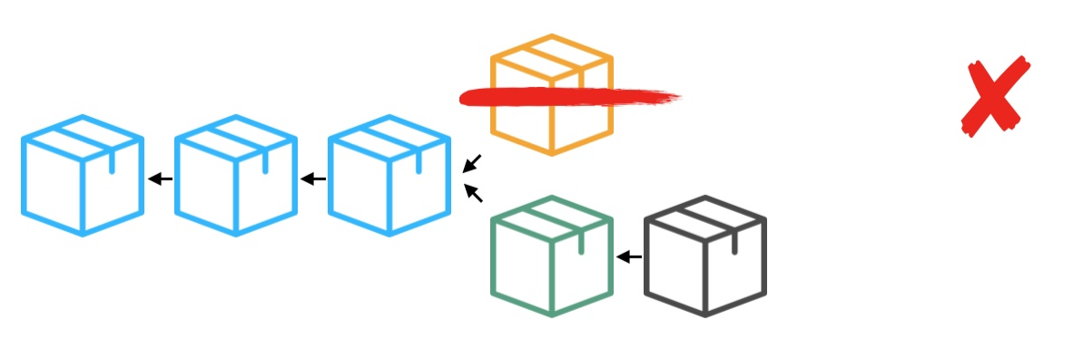
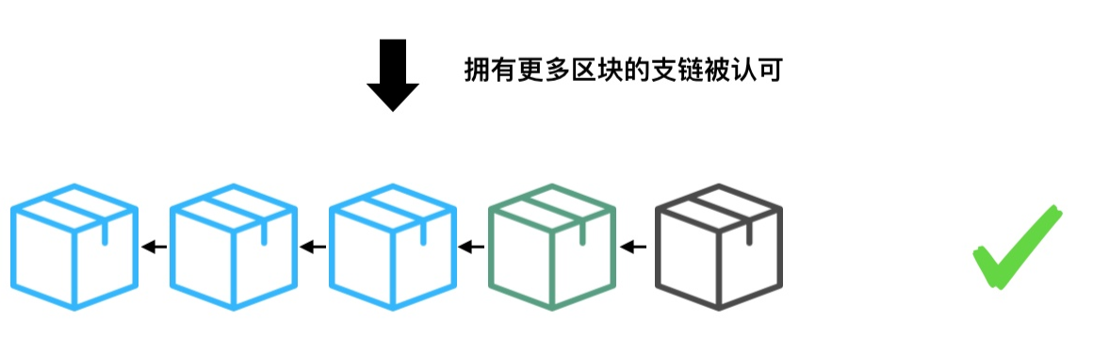

Consensus
分叉 & 双花

Slide 9
二
BlockFL System
Federated learning on blockchain

Slide 10
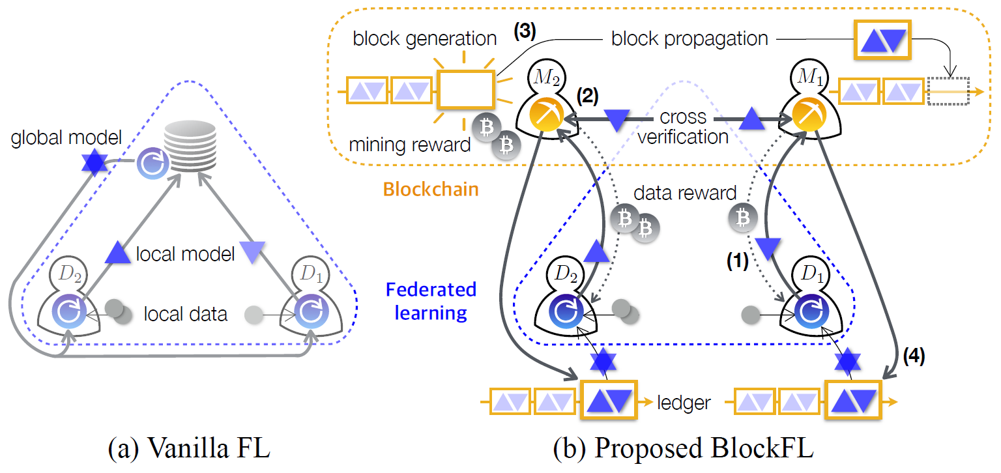

BlockFL System
Federated learning on blockchain

Slide 11
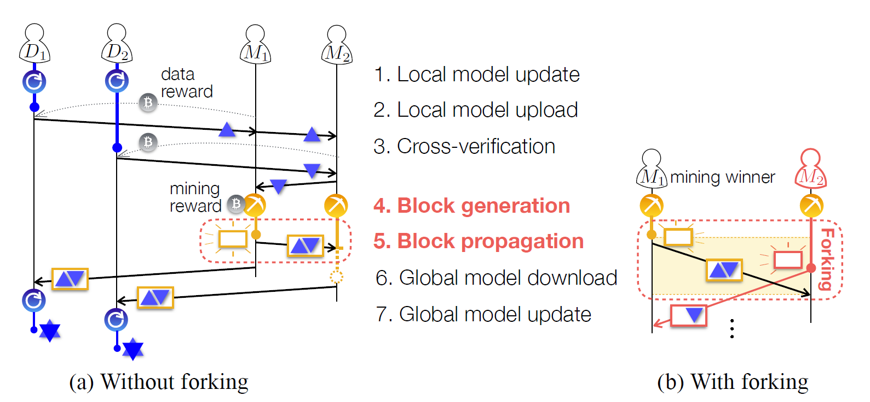

Follow work
Without forking

Slide 12
三
BlockBL Algorithm
Local & Global

Slide 13
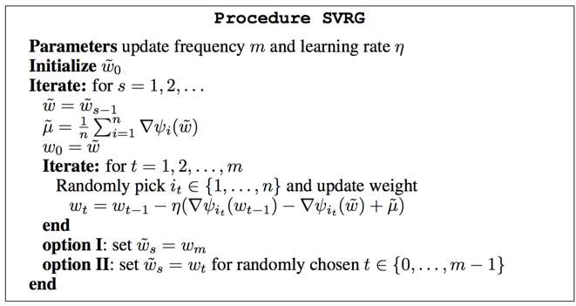
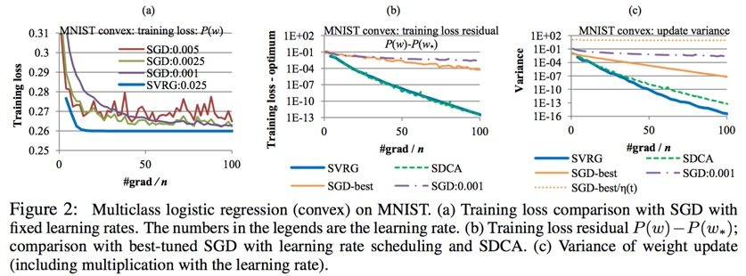

Algorithm
Local & global
每过一段时间计算一次所有样本的梯度$μ，$每个阶段内部的单次更新采用
来更新当前参数，这种特殊的更新项来让方差有一个可以不断减少的上界，因此也就做到了线性收敛

Slide 14
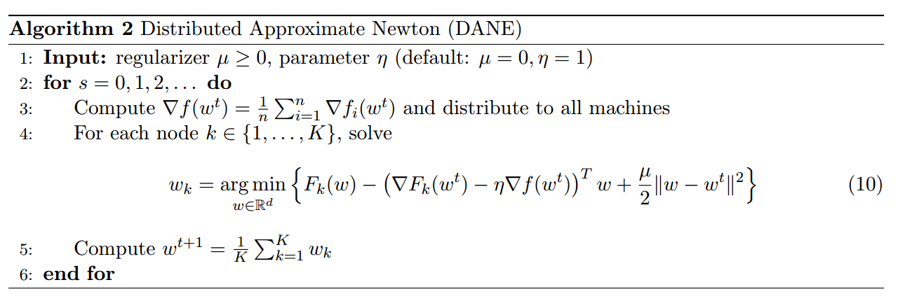
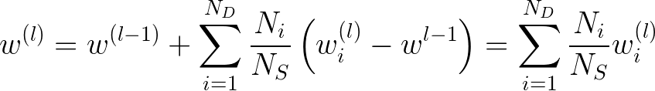

Algorithm
Local & global

Slide 15

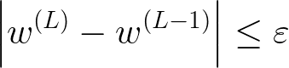
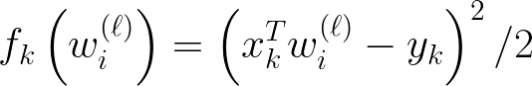
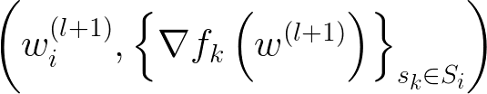
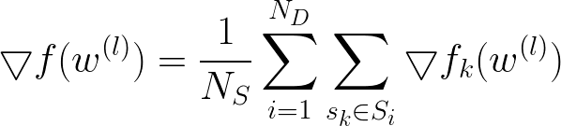
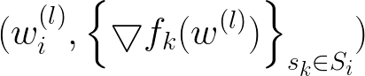

Slide 16
四
Latency Analysis

Slide 17
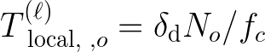
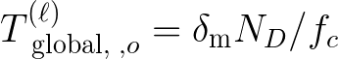
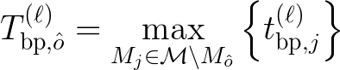
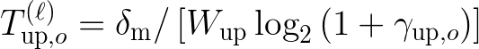

Latency

Slide 18
五
Final Summary
Problems & Bright spot

Slide 19
Problems

DANE

真实性验证
→
奖励机制
⬆
作恶考虑

异步下，epoch错开重连

参数量大后的考虑 & 一些细节

Slide 20
Bright spot

把FL与区块链结合，并形式化表达
⬆
加入了SGX， POET共识等较新技术

Slide 21
六
QA
kingsonwill@edu.zju.cn

Slide 22
THANK YOU

Slide 23
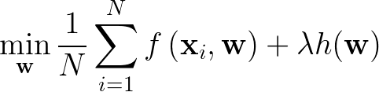
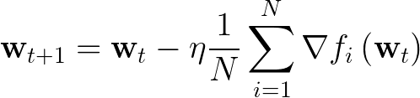
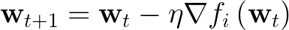

Algorithm
Local & global
Target：
GD：
Gradient Descent
精度高
SGD：
Stochastic Gradient Descent
收敛快

